Slide 1
Chapter 11: Sequential Circuits and Finite State Machines
Notes:
Welcome to sequential circuits and Finite State Machines.
This will be the last chapter to have homework assigned.
We are in the home stretch!

Slide 2
Sequential Circuits
Combinational logic
Need immediate application of Boolean function to a set of inputs
Will not work when circuit needs to change value with consideration to current state and inputs
Need to “remember” the current state
Sequential logic circuits provide this functionality
Notes:
Combinational logic circuits are perfect for situations when we require the immediate application of a Boolean function to a set of inputs.
There are other times, however, when we need a circuit to change its value with consideration to its current state as well as its inputs.
These circuits have to “remember” their current state.
Sequential logic circuits provide this functionality for us.

Slide 3
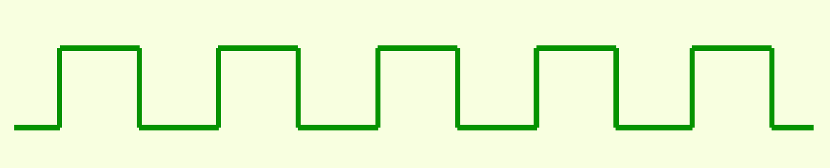
Sequential Circuits
Sequential logic circuits require events to be sequenced
Clocks
Control state changes
Special circuit that sends electrical pulses through a circuit
Produce electrical waveforms as shown below
Notes:
As the name implies, sequential logic circuits require a means by which events can be sequenced.
State changes are controlled by clocks.
A “clock” is a special circuit that sends electrical pulses through a circuit.
Clocks produce electrical waveforms such as the one shown below.

Slide 4
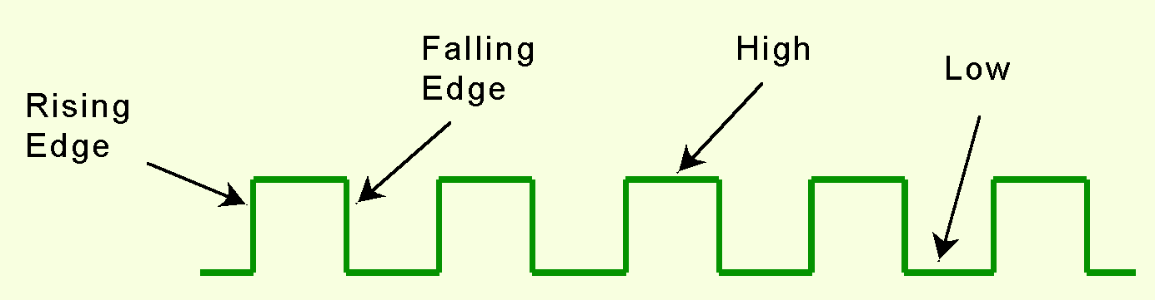
Sequential Circuits
State changes occur in sequential circuits at clock ticks
Circuits can change state
on the rising edge -or-
falling edge -or-
when the clock pulse reaches its highest voltage
Notes:
State changes occur in sequential circuits only when the clock ticks.
Circuits can change state on the rising edge, falling edge, or when the clock pulse reaches its highest voltage

Slide 5
Sequential Circuits
Edge-triggered circuits change state on
the rising edge of the clock pulse
or falling edge of the clock pulse
Level-triggered circuits change state when
clock voltage reaches highest or lowest level
Notes:
Circuits that change state on the rising edge, or falling edge of the clock pulse are called edge-triggered.
Level-triggered circuits change state when the clock voltage reaches its highest or lowest level.

Slide 6
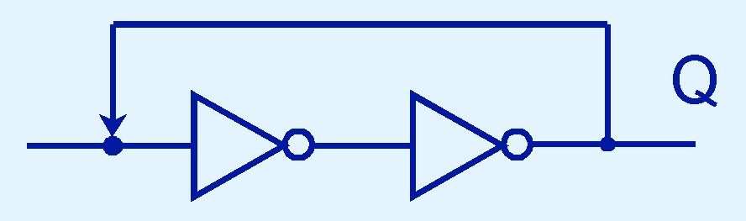
Sequential Circuits
Sequential circuits rely on feedback
Feedback
output is looped back to the input
Example of this concept shown below
If Q is 0 it will always be 0, if it is 1, it will always be 1. Why?
Notes:
To retain their state values, sequential circuits rely on feedback.
Feedback in digital circuits occurs when an output is looped back to the input.
A simple example of this concept is shown below.
If Q is 0 it will always be 0, if it is 1, it will always be 1. Why?
If it is 0 here, it will be 1 here and it will be 0 here. This will be true at each clock tick. Remember we are including time now.
If it is 1 here, it will be 0 here and it will be 1 here.

Slide 7
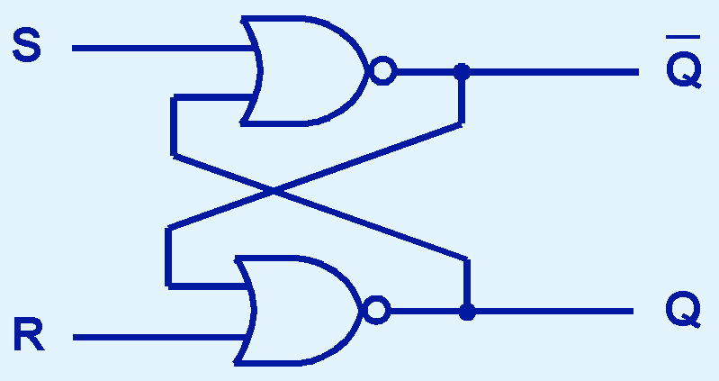
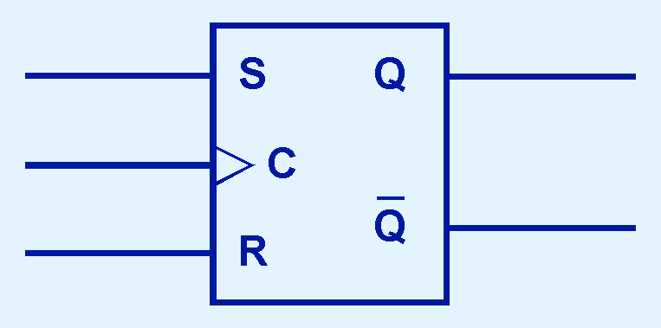
Sequential Circuits
SR Latch (flip-flop)
“SR” stands for set/reset
most basic sequential logic components
SR latch circuit & block diagram shown below
Notes:
You can see how feedback works by examining the most basic sequential logic components, the SR Latch (flip-flop).
The “SR” stands for set/reset.
The internals of an SR latch are shown below, along with its block diagram.
Note – the two screen shots here are what is expected for the discussion question this week.

Slide 8
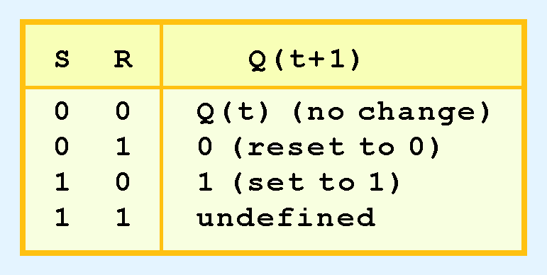
Sequential Circuits
Behavior of SR latch
described by a characteristic table
Q(t)
value of the output at time t
Q(t+1)
value of Q after the next clock pulse
x | y | out = x NOR y
0 | 0 | 1
1 | 0 | 0
0 | 1 | 0
1 | 1 | 0
Notes:
The behavior of an SR latch is described by a characteristic table.
Q(t) means the value of the output at time t.
Q(t+1) is the value of Q after the next clock pulse
<click>
Let’s add the truth table for NOR as a reference.
Here are the values at the initial state with S & R at zero.
If R – reset goes to 1, then Q is reset to 0 and Q-bar is reset to 1
If S – signal goes to1, then Q goes to 1 and Q bar goes to 0
Let’s draw the truth table for the SR Latch.

Slide 9
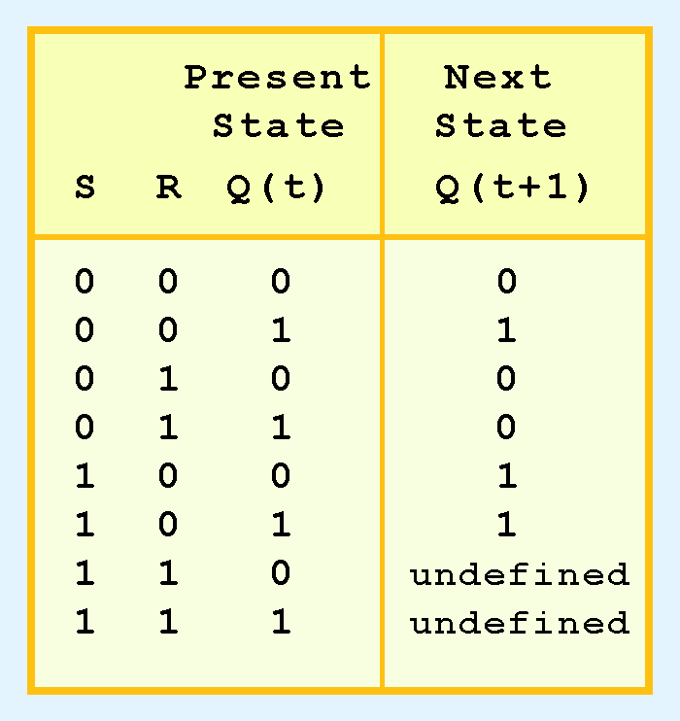
Sequential Circuits
SR latch- three inputs:
S, R, current output: Q
Note: two undefined values
S and R are both 1 –
SR flip-flop is unstable
Notes:
The SR latch actually has three inputs: S, R, and its current output, Q.
Thus, we can construct a truth table for this circuit, as shown at the right.
Notice the two undefined values. When both S and R are 1, the SR flip-flop is unstable.

Slide 10
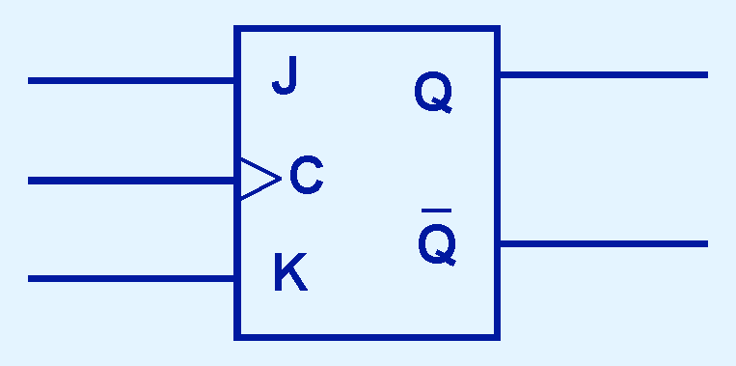
Sequential Circuits
If inputs to an SR latch will never both be 1
Then circuit will never be unstable
Modified SR latch
Provides stable state when both inputs are 1
Modified flip-flop is called JK flip-flop
“JK” is in honor of Jack Kilby
Notes:
If we can be sure that the inputs to an SR latch will never both be 1, we will never have an unstable circuit. This may not always be the case.
The SR latch can be modified to provide a stable state when both inputs are 1.
The Modified flip-flop is called a JK flip-flop, shown here.
The “JK” is in honor of Jack Kilby.

Slide 11
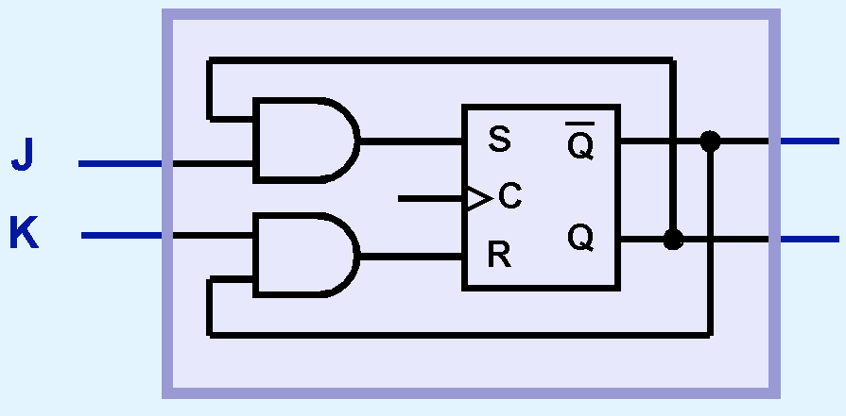
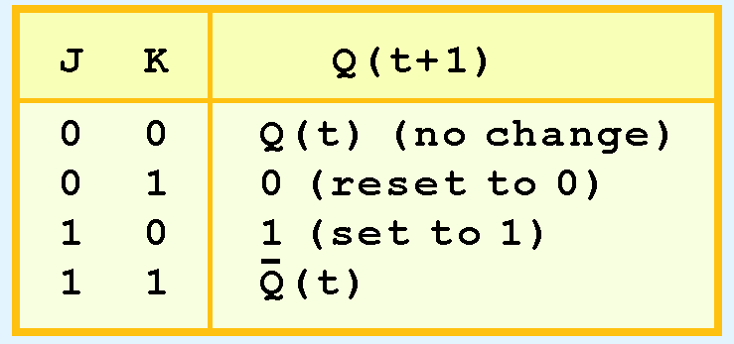
Sequential Circuits
JK flip-flop
Modified SR flip-flop
Adding 2 ANDs
Characteristic table indicates
stable for all inputs
Notes:
At the right, we see how an SR flip-flop can be modified to create a JK flip-flop by adding two ANDs.
The characteristic table indicates that the flip-flop is stable for all inputs.

Slide 12
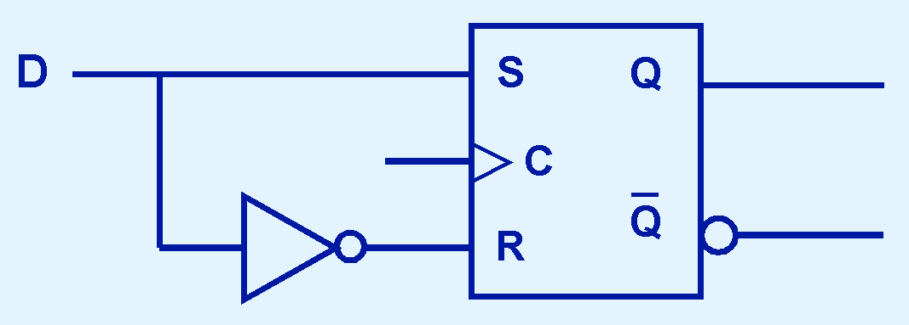
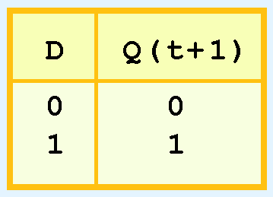
Sequential Circuits
D flip-flop – Data flip-flop
Another modification of SR flip-flop
Characteristic table is shown
Output changes
when the value of D changes
Stores D (data) until next clock pulse
Notes:
Another modification of the SR flip-flop is the D flip-flop, shown below with its characteristic table.
You will notice that the output of the flip-flop remains the same during subsequent clock ticks.
The output changes only when the value of D changes. This is used to store a data values until the D input changes.

Slide 13
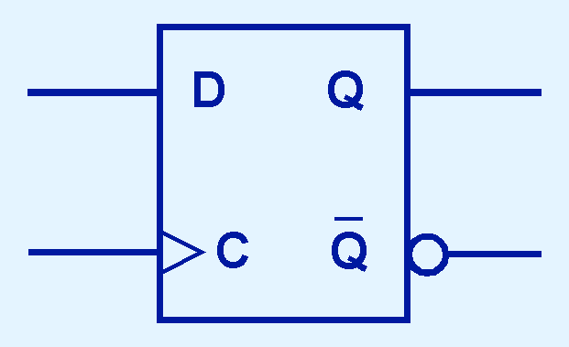
Sequential Circuits
D flip-flop
fundamental circuit of computer memory
Block diagram & Characteristic table for D flip-flop are shown below
Notes:
D flip-flop is the fundamental circuit of computer memory.
D flip-flops are usually illustrated using the block diagram shown below.
And the characteristic table for the D flip-flop is shown at the right.

Slide 14
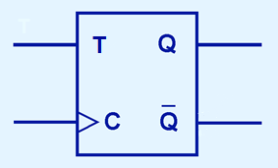
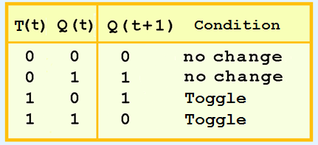
Sequential Circuits
T flip-flop – Toggle flip-flop
Only one input T
Output changes
If T=0 – state remains the same
If T=1 – state toggles from 0 to 1 or from 1 to 0
Block diagram & Characteristic table for T flip-flop are shown below
Notes:
T flip-flop – Toggle flip-flop
Only one input T
Output changes
If T=0 – state remains the same
If T=1 – state toggles from 0 to 1 or from 1 to 0
Block diagram & Characteristic table for T flip-flop are shown below

Slide 15
Sequential Circuits
Characteristic tables or finite state machines (FSMs)
Express behavior of sequential circuits
FSMs consist of
set of nodes that hold the states of the machine
set of arcs that connect the states
Moore and Mealy machines are two types of FSMs
Moore machines place outputs on each node
Mealy machines present their outputs on the transitions
They are equivalent
Textbook uses Mealy Machine Convention
Notes:
The behavior of sequential circuits can be expressed using characteristic tables or finite state machines (FSMs).
FSMs consist of a set of nodes that hold the states of the machine and a set of arcs that connect the states.
Moore and Mealy machines are two types of FSMs that are equivalent.
They differ only in how they express the outputs of the machine.
Moore machines place outputs on each node, while Mealy machines present their outputs on the transitions.
Our textbook uses the Mealy Machine Convention

Slide 16
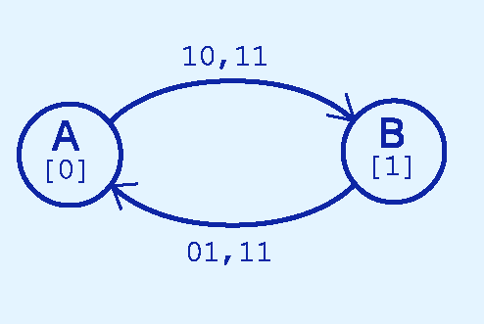
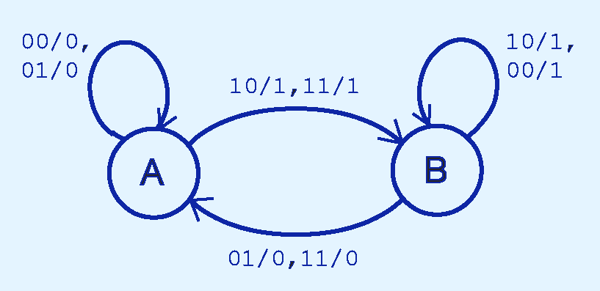
Sequential Circuits
Behavior of JK flop-flop is depicted below
Moore machine
Mealy machine
Notes:
The behavior of JK flop-flop is depicted below by a Moore machine on the left and a Mealy machine on the right.

Slide 17
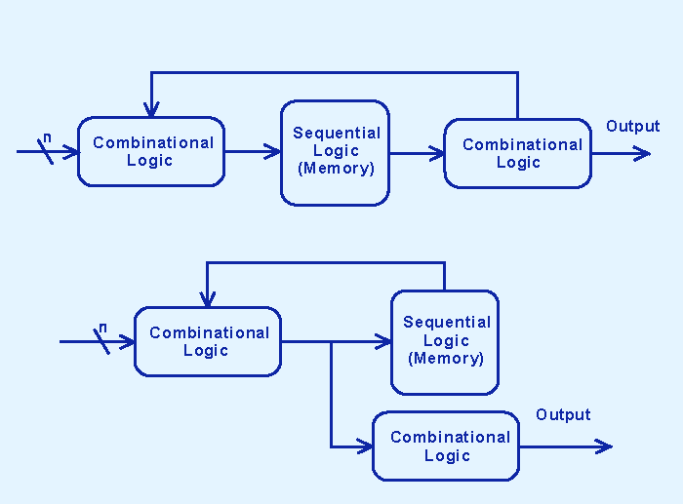
Sequential Circuits
Behavior of Moore and Mealy machines is identical
Implementations differ
Implementation of Moore machine
Notes:
Although the behavior of Moore and Mealy machines is identical, their implementations differ.
Here is the implementation of the Moore machine

Slide 18
Sequential Circuits
Implementation of Mealy machine
Notes:
And here is the implementation of the Mealy machine

Slide 19
Sequential Circuits
Sequential circuits are used for “stateful” applications
Stateful application - next state of the machine
Depends on the current state of the machine
Depends on the input.
Stateful application requires
Combinational and
Sequential logic
Notes:
Sequential circuits are used anytime that we have a “stateful” application.
A stateful application is one where the next state of the machine depends on the current state of the machine and the input.
A stateful application requires both combinational and sequential logic.
The following slides provide several examples of circuits that fall into this category.

Slide 20
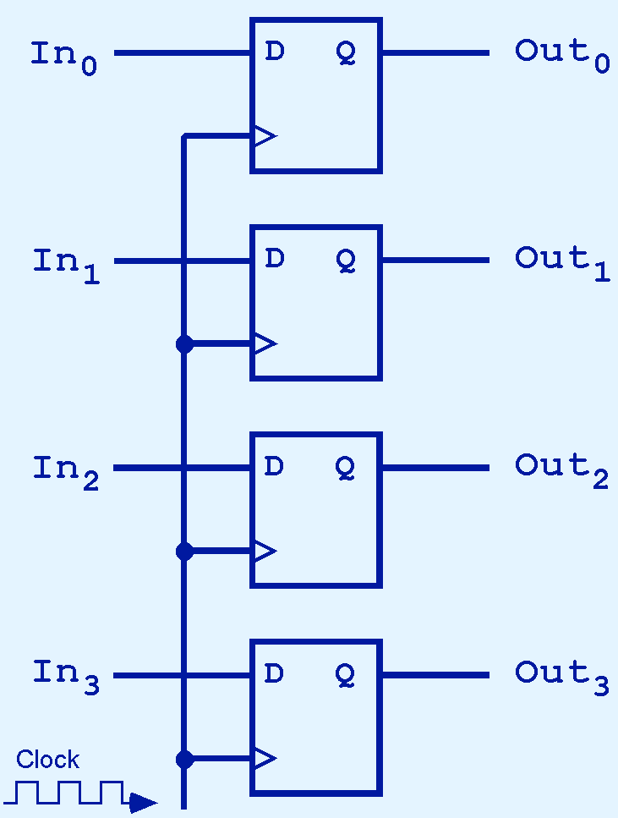
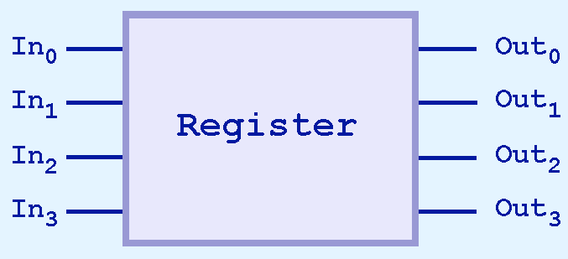
Sequential Circuits
4-bit register consisting of D flip-flops on the right
Usual block diagram below
Notes:
This illustration shows a 4-bit register consisting of D flip-flops. You will usually see its block diagram as it is below instead.

Slide 21
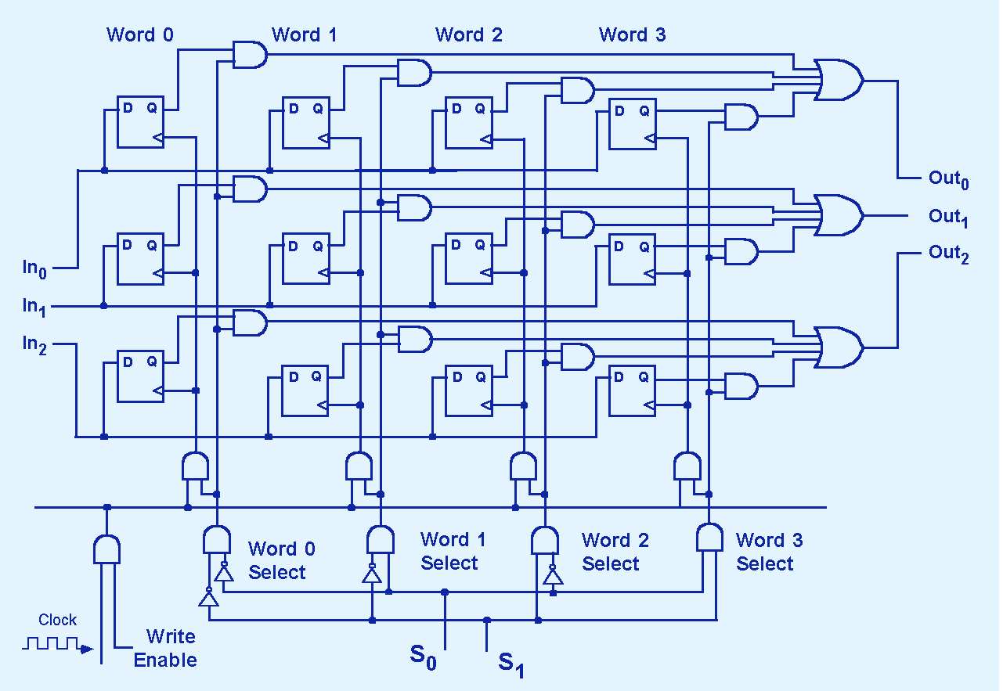
Sequential Circuits
Notes:
Here is a larger memory configuration with D Flip-Flops.

Slide 22
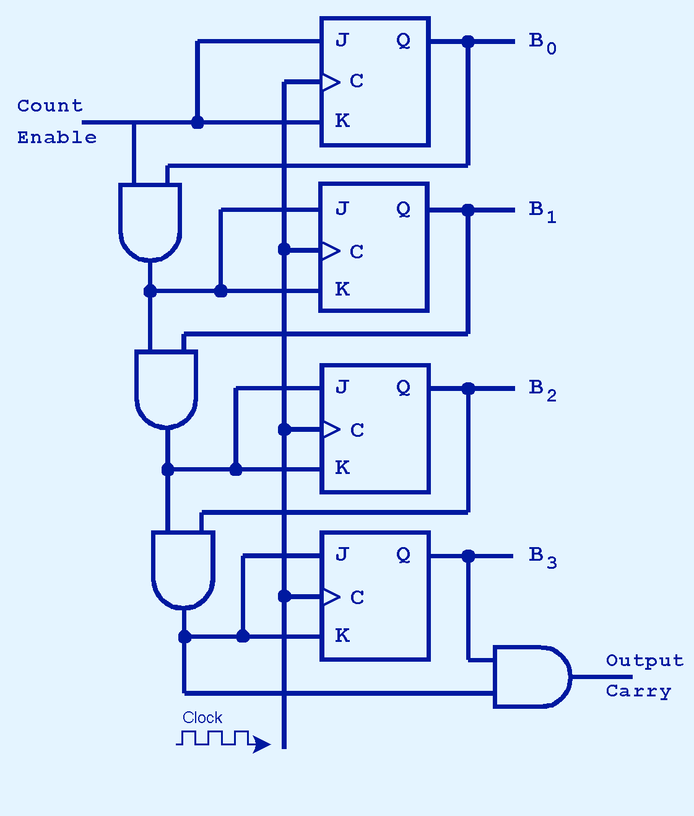
Sequential Circuits
Binary counter
Low-order bit is complemented at each clock pulse
Whenever it changes from 0 to 1, the next bit is complemented, and so on through the other flip-flops.
Notes:
A binary counter is another example of a sequential circuit.
The low-order bit is complemented at each clock pulse.
Whenever it changes from 0 to 1, the next bit is complemented, and so on through the other flip-flops.

Slide 23
Finite State Machines
Finite State Machine - tool to model sequential logic components
Mealy/Moore machines describe sequential logic
Finite State Machines are used to design control units for CPUs
Finite state machine consists of
a finite number of states represented by the different values stored in a register
a number of external inputs and external outputs
boolean functions for the outputs of the machine according to the current state
boolean functions to determine the next state according to current state and the current values of the external inputs
Notes:
The Finite State Machine is tool to model sequential logic components in computer organization.
We saw these Mealy/Moore machines in describing sequential logic.
finite state machines are primarily used in the design of control units for CPUs.
A finite state machine consists of
a finite number of states represented by the different values stored in a register
a number of external inputs and external outputs
boolean functions for the outputs of the machine according to the current state
boolean functions to determine the next state according to current state and the current values of the external inputs

Slide 24
Finite State Machines
Design of a sequential circuit
More difficult because of "statefullness" of the circuit components.
First develop a finite state machine (FSM)
Consists of states and inputs
State and inputs determine next state and possible outputs
From FSM model, produce state table
From state table, produce sequential circuit
Notes:
We want to design a sequential circuit.
More difficult because of "statefullness" of the circuit components.
First develop a finite state machine (FSM)
It consists of states and inputs.
The State and inputs determine next state and possible outputs.
From the model, a state table can be produced – like the truth tables for combinational circuits.
From state table, the sequential circuit can be produced.

Slide 25
Finite State Machines
Finite State Machine is represented by:
state transition diagram
each node represents a state
the edge from state s1 to s2 with label for the external input value represents that state transition from s1 to s2 under the condition of the inputs described by the label
Notes:
Finite State Machine can be represented by a state transition diagram where
each node represents a state
and the edge from state s1 to s2 with label for the external input value represents that state transition from s1 to s2 under the condition of the inputs described by the label.

Slide 26
Finite State Machines
state of truth tables to describe the state transition functions where
the inputs of the tables are the binary values of the current state and the current external inputs
the outputs of the functions are the binary values of the next state of the transition
Notes:
It can also be represneted by a state of truth tables to describe the state transition functions where
the inputs of the tables are the binary values of the current state and the current external inputs
the outputs of the functions are the binary values of the next state of the transition.

Slide 27
Finite State Machines
Example: 3-bit up counter - finite state machine with
8 states represented by a 3-bit register (3 D flip-flops) named as Q2, Q1, Q0
no external inputs
the following state transition diagram
000
001
010
011
100
101
110
111
Notes:
For example, a 3-bit up counter is a finite state machine which
has 8 states represented by a 3-bit register (3 D flip-flops) named as Q2, Q1, Q0
has no external inputs
has the following state transition diagram

Slide 28
Finite State Machines
Implementation of finite state machine
state transitions - implemented by the combinational logic for the boolean functions which input:
the current state and
the current value of external inputs
use the outputs for the D inputs of the D flip-flops
So next state is reached at beginning of next clock tick
Notes:
Implementation of finite state machine
the state transitions are implemented by the combinational logic for the boolean functions which take
the current state and
the current value of external inputs
as inputs and use the outputs for the D inputs
of the D flip-flops so that the next state can be reached at the beginning of the next clock tick on the rising edge.

Slide 29
Mealy FSM
Output Is a Function of a Present State and Inputs
Inputs
Transition
function
Next State
Present State
Memory
(register)
Output
function
Outputs
Notes:
Here is the implementation of the Mealy machine again with color codes with a bit different labels to relate it to the next slide.

Slide 30
Mealy Machine
Describe Outputs as Concurrent Statements Depending on State and Inputs
transition condition 1 /
output 1
state 1
state 2
transition condition 2 /
output 2
Notes:
Here is the basic definition of the Mealy machine and we will apply it to the J-K flip-flop.
Let’s start at State A. It is when the output is 0.
If 00 or 01 are input at the next tick, then the self arc indicates that the output will be zero and the state will remain at A.
If while at State A, inputs of 10 or 11 occur at the next tick, then this arc indicates that the output will change to 1 and the state will change to B.
While at State B, if 10 or 00 are input at the next tick, then the self are indicates that the output will be one and the state will remain at B.
If while at State B, inputs of 01 or 11 occur at the next tick, then this arc indicates that the output will change to 0 and the state will change to A.

Slide 31
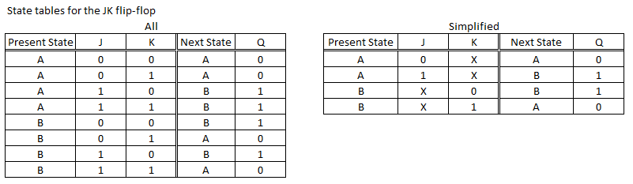
JK Flip-flop Example
Recall when J=1, sets flip-flop to 1
when K=1, sets flip-flop to 0
State table shown below
Notes:
Recall when J=1, sets flip-flop to 1
when K=1, sets flip-flop to 0
The state tables are shown here. The one on the left shows all rows and the one on the right is simplified with don’t cares.
Note that each of the lines on the table on the right represents one arc in the finite state machine shown in the previous slide.

Slide 32
Finite State Machines
Example 1: Alarm clock FSM example
start with a state table
then create state "machine“
represent states as circles
each transition (action) is represented as an arc
FSM arcs must be mutually exclusive: cannot have two arcs with same input conditions (aka non-deterministic FSM).
Notes:
Let’s look at an Alarm clock FSM example
start with a state table, then create state "machine“
represent states as circles
each transition (action) is represented as an arc
FSM arcs must be mutually exclusive: cannot have two arcs with same input conditions (aka non-deterministic FSM).

Slide 33
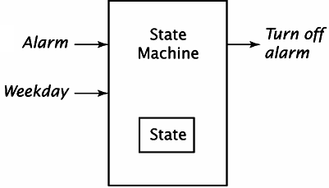
FSM Alarm Clock Example
Events:
Wake up at fixed time every day
Weekends: you don’t need alarm, so you wake up, turn off the alarm and resume sleep
FSM modeling this chain of events, with:
Three states:
Asleep
Awake but still in bed
Awake and up
Inputs:
Alarm
Weekday (determines you how to react to alarm)
Outputs:
Turn off the alarm
Notes:
The Events for this are:
Wake up at fixed time every day
Weekends: you don’t need alarm, so you wake up, turn off the alarm and resume sleep
FSM modeling this chain of events, with:
There are three states:
Asleep
Awake but still in bed
Awake and up
There are two Inputs:
Alarm
Weekday (determines you how to react to alarm)
There is one Output:
Turn off the alarm

Slide 34
State tables
Present State | Inputs | Next State | Outputs
Similar to the truth table
Doesn’t contain the system clock when specifying its transitions
All the transitions occur on positive edge of the clock unless otherwise stated
Notes:
State tables are similar to truth tables.
It doesn’t contain the system clock when specifying its transitions (it is implicit that transitions occur only when allowed by clock)
Unless different stated, all the transitions are occurring on the positive edge of the clock

Slide 35
Alarm clock state table
Present State | Alarm | Weekday | Next State | Turn off alarm
Asleep | On | X | Awake in bed | Yes
Awake in bed | Off | Yes | Awake and up | No
Awake in bed | Off | No | Asleep | No
Asleep and alarm rings
Transition from being asleep to being awake in bed
Turn off the alarm
Awake in bed and Weekday
You get up
Awake in bed and not Weekday
You go back to sleep
Table doesn’t cover what you wouldn’t do…
(i.e. Asleep and the alarm is off, you remain asleep, etc..)
Notes:
When you are asleep and alarm rings, you go from being asleep to being awaked in bed; you also turn off the alarm
If you are awake in bed and it is a weekday, You get up
If you are awake in bed and it is not a weekday, You go back to sleep
This table doesn’t cover what you wouldn’t do…(i.e. if you are asleep and the alarm doesn't go off, you remain asleep, etc..)

Slide 36
Alarm clock state table
Present State | Alarm | Weekday | Next State | Turn off alarm
Asleep | Off | X | Asleep | No
Asleep | On | X | Awake in bed | Yes
Awake in bed | On | X | Awake in bed | Yes
Awake in bed | Off | Yes | Awake and up | No
Awake in bed | Off | No | Asleep | No
Awake and up | X | X | Awake and up | No
Covers all the cases
First row: Asleep and the alarm is off so you remain asleep
Last row : Awake and up so you remain awake and up
Third row: Awake and in bed and the alarm rings so you remain Awake in bed and turn it off
Notes:
This state table covers all the cases.
First row covers the situation you are asleep, the alarm is off and you remain asleep
Last row covers the situation you are awake and up and you remain awake and up
The third row covers the case you are awake and in bed and the alarm rings. You remain Awake in bed and turn it off.

Slide 37
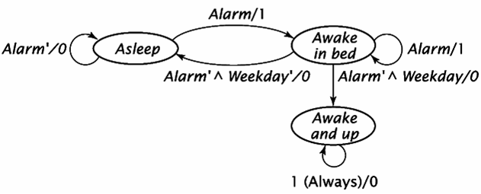
State diagram
Graphical representation of the state table
Each state = circle vertex
Each row of the state table = directed arc from:
present state vertex to the next state vertex
Outputs are associated with the arcs
Output of 1 = “turn off the alarm” is Yes
Inputs which are don’t care and inactive outputs are not shown
Notes:
Here is the state diagram for the alarm clock example.
It is a graphical representation of the state table
Each state is represented by a circle vertex
Each row of the state table is represented as a directed arc from present state vertex to the next state vertex
The outputs are associated with the arcs
An output of 1 represents that “turn off the alarm” is Yes
By convention , inputs which are don’t care and inactive outputs are not shown

Slide 38
State machines
Mealy machine (used in text):
Associates its outputs with the transitions
Format of the label of each arc is Inputs/Outputs
Self arcs must be shown (because the output values are shown on the arcs)
Notes:
The Mealy machine used in this text associates its outputs with the transitions.
In addition to the input values, each arc also shows the output values generated during the transition; the format of the label of each arc is Inputs/Outputs.
Self arcs must be shown (because the output values are shown on the arcs)

Slide 39
Designing from System Specifications
From a set of specifications, we want to develop
State Table
State Diagram
Example 2. Modulo 6 Counter specifications:
Counts 000, 001, 010, 011, 100, 101
One input U:
1 = increment,
0 = don't increment
Three outputs (bits): V2, V1, V0
Output bit C is 1 when transitioning from S5 to S0 (remains 1 until first transition)
Machine has 6 states, representing six outputs: S0 ... S5
Notes:
To Design from system specifications, first develop the state table then the state diagram.
Lets look at another example of a modulo 6 counter
It counts in binary from 0 up to 5
It has one input – if it is 1 then increment the number – if it is 0 do not increment
It has three outputs – one for each of the binary bits
Output bit C is 1 when going from 6 to 0
The machine has six states – one for each number

Slide 40
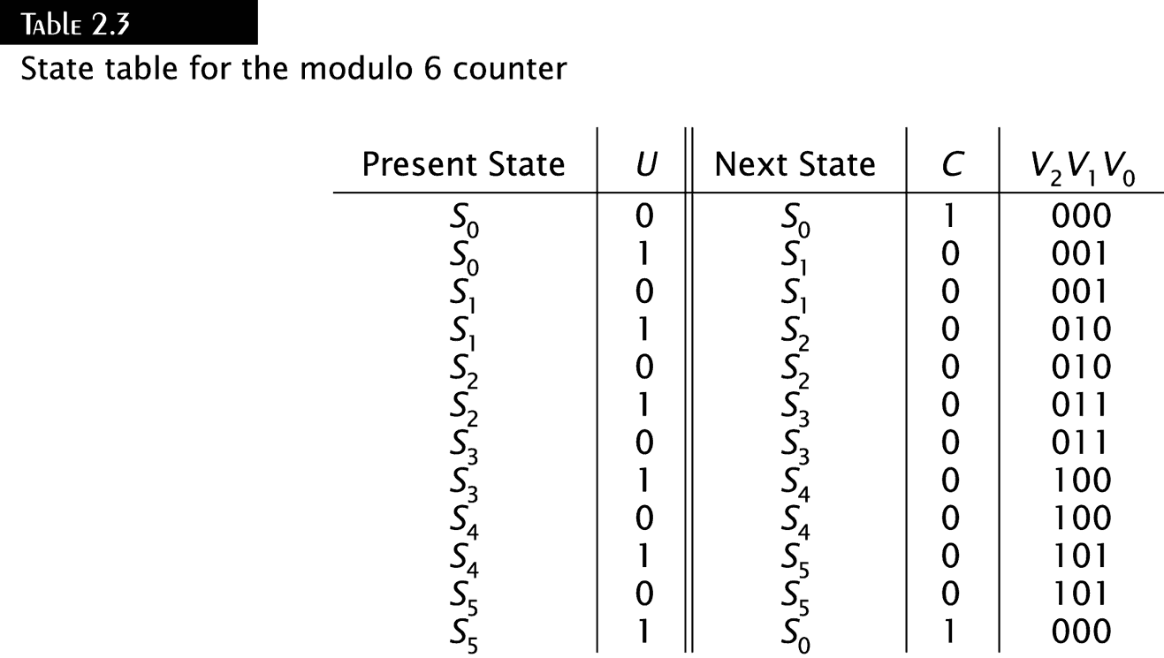
State Table for modulo 6 counter
Notes:
Here is the state table for each case.

Slide 41
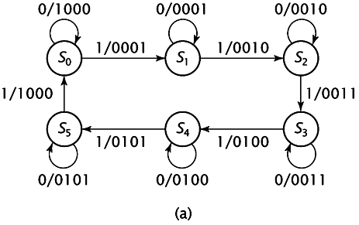
State Diagrams for Modulo 6 Counter
Mealy Machine
Notes:
And here is the Mealy machine representation for it.
Note the carry bit is represented as the leftmost binary digit in the output.

Slide 42
Finite State Machines
Any Circuit with Memory Is a Finite State Machine
Even computers can be viewed as huge FSMs
Design of FSMs Involves
Defining states
Defining transitions between states
Optimization / minimization
Above Approach Is Practical for Small FSMs Only
Notes:
Any Circuit with Memory Is a Finite State Machine
Even computers can be viewed as huge FSMs
The design of FSMs involves
First defining the states
Next defining the transitions between states
Finally, it is optimized & minimized
Note: This approach Is Practical for Small FSMs Only

Slide 43
State Encoding
State Encoding Can Have a Big Influence on Optimality of the FSM Implementation
No methods other than checking all possible encodings are known to produce optimal circuit
Feasible for small circuits only
Notes:
State Encoding Can Have a Big Influence on Optimality of the FSM Implementation
There are no methods other than checking all possible encodings are known to produce optimal circuit
Again, this is feasible for small circuits only.

Slide 44
Types of State Encodings
Binary (Sequential) – States Encoded as Consecutive Binary Numbers (used in the text)
Small number of used flip-flops
Potentially complex transition functions leading to slow implementations
One-Hot – Only One Bit Is Active (used in many small real-world devices)
Number of used flip-flops as big as number of states
Simple and fast transition functions
Notes:
Here are two types of state encodings:
In Binary or Sequential coding the States are encoded as Consecutive Binary Numbers. This is used in the text
This uses a small number of used flip-flops, however it has potentially complex transition functions leading to slow implementations.
In One-Hot coding only one bit is active. This is used in many small real-world devices.
The number of used flip-flops as big as the number of states, however it has simple and fast transition functions.

Slide 45
Types of State Encodings (2)
State | Binary Code | One-Hot Code
S0 | 000 | 10000000
S1 | 001 | 01000000
S2 | 010 | 00100000
S3 | 011 | 00010000
S4 | 100 | 00001000
S5 | 101 | 00000100
S6 | 110 | 00000010
S7 | 111 | 00000001
Notes:
Here is a comparison of the Binary coded state and the One-Hot coded state.
Review the Gumball Machine presentation for an example of two different encoding techniques and their effects.

Slide 46
Inputs
FSMs change state based on clock edges
I.e. Rising clock edge clocks all flip flops
This part can change only when clock “ticks”
State
FlipFlops
Comb. Logic For
Outputs
Clock
Combinational Logic
For Next State
Synchronous Inputs: Change in synch with the clock. Obey setup and hold time.
This part can change at any time
Asynchronous Inputs: Change at any time. May violate setup and hold times.
Inputs
Notes:
Finite State Machines change state based on clock edges – For example flip flops change on the rising clock edge.
<click>
The section in pink can only change when the clock “ticks”
<click>
This is called synchronous Input. It changes in synch with the clock.
<click>
The section in blue can change any time.
<click>
It is called asynchronous Input. It changes irregardless of the clock.

Slide 47
Asynchronous vs. Synchronous Inputs
Asynchronous
Synchronous
Example: Elevator pushbuttons
Arrive at any time
Usually asserted for many clock cycles
FSM logic must not make any assumptions about input timing
Example: Data arriving on a serial line from a computer
Arrive synchronized exactly to a clock
One bit of data per clock cycle
FSM can assume that data changes once per clock cycle
Notes:
<click>
Elevator pushbuttons are examples of asynchronous input and the positions of the elevator are the various states.
They can arrive at any time and may be asserted for many cycles.
If the elevator is on 1 and buttons 3 &5 are pushed. The 5 must remain asserted after stopping at 3.
The logic can not make any assumptions about input timing.
All the floor requests will not be made at 1, someone may push 7 when moving from 3 to 5.
Synchronous inputs are much more controlled, for example data arriving on a serial line from a computer.
It must arrive synched to the clock and have one bit of data per clock cycle.
The FSM logic can assume that the data changes only once per clock cycle.
This is all on sequential circuits. Please review the presentation on Computer subsystems also before taking the quiz.
Also review the examples on the gum ball machine and the pattern matcher before doing the homework.

